Slide 1

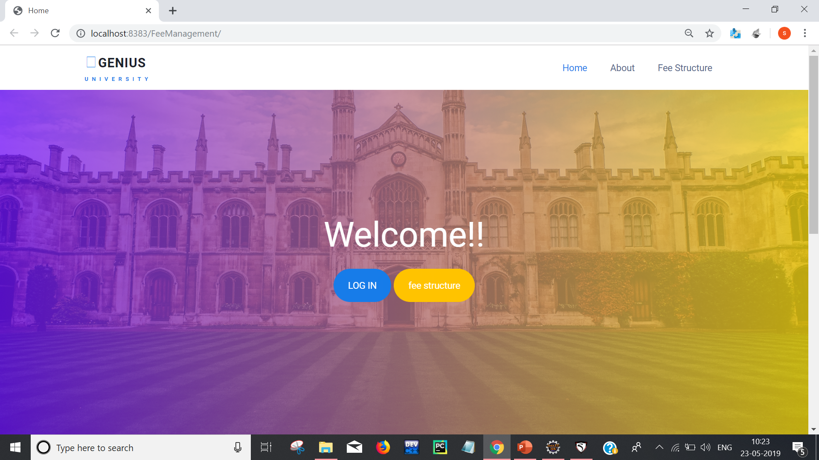
FEE MANAGEMENT SYSTEM
Developed By:
Rupali Choudhary (1610991737)
Sahil Kalra (1610991749)
Sahaj (1610991745)

Slide 2
FEE MANAGEMENT SYSTEM
Project Statement
Our aim is to develop a Java Based Application. This application aims to enhance the ease of monitoring fee management at any location.
This project use database to store the information about the paid fees and dues. Admin will have the access to delete , update and create the records while the students have the access to read the records.
A Java based interface will be created to control the database and user login..

Slide 3
FEE MANAGEMENT SYSTEM
Technology Used
Eclipse
Tomcat 9.0
MySQL Workbench
HTML
CSS
IDE: JEE IDLE

Slide 4
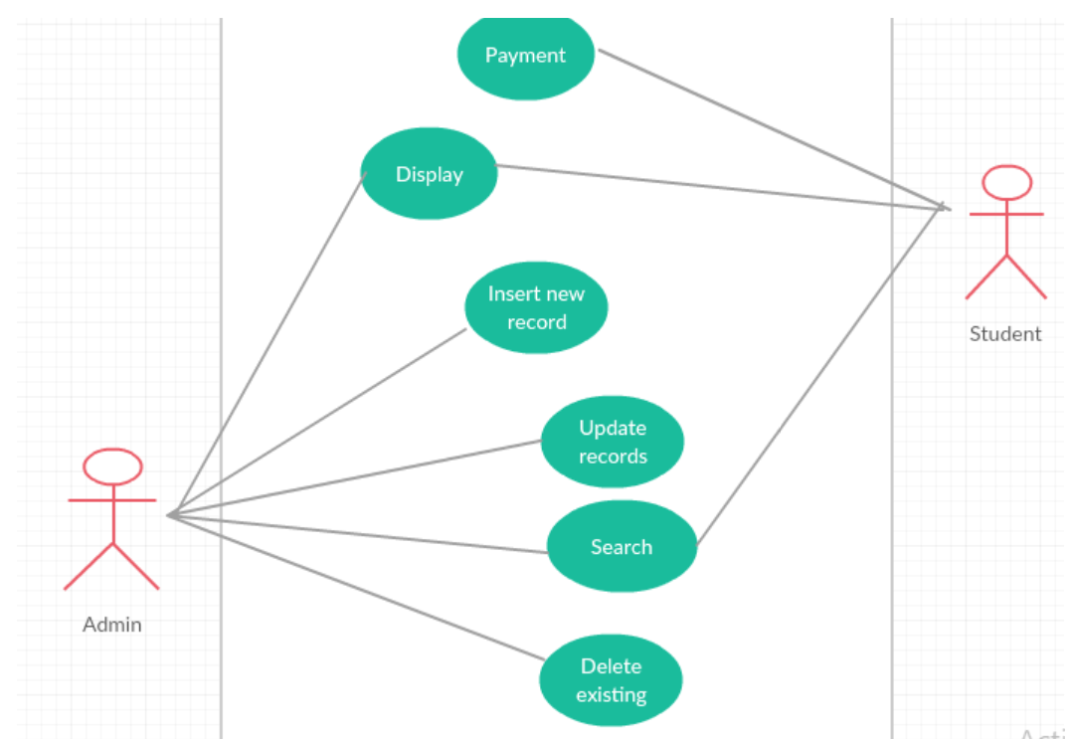
FEE MANAGEMENT SYSTEM
Flow Diagram

Slide 5
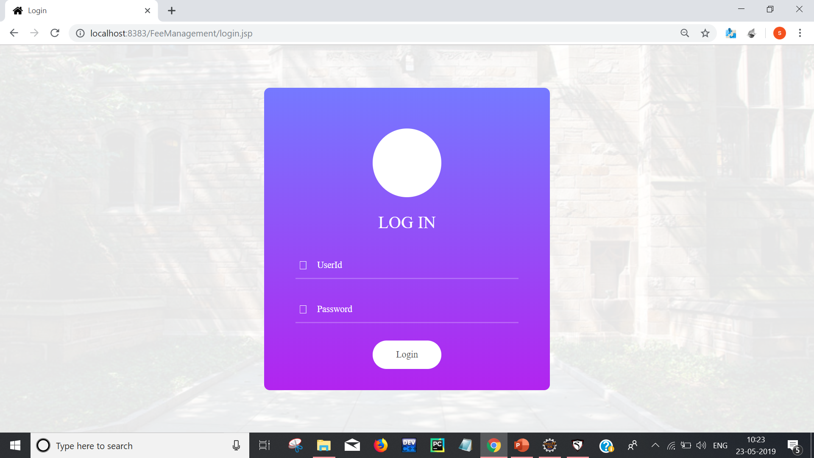
FEE MANAGEMENT SYSTEM
Snapshots :
Front Page For Login

Slide 6
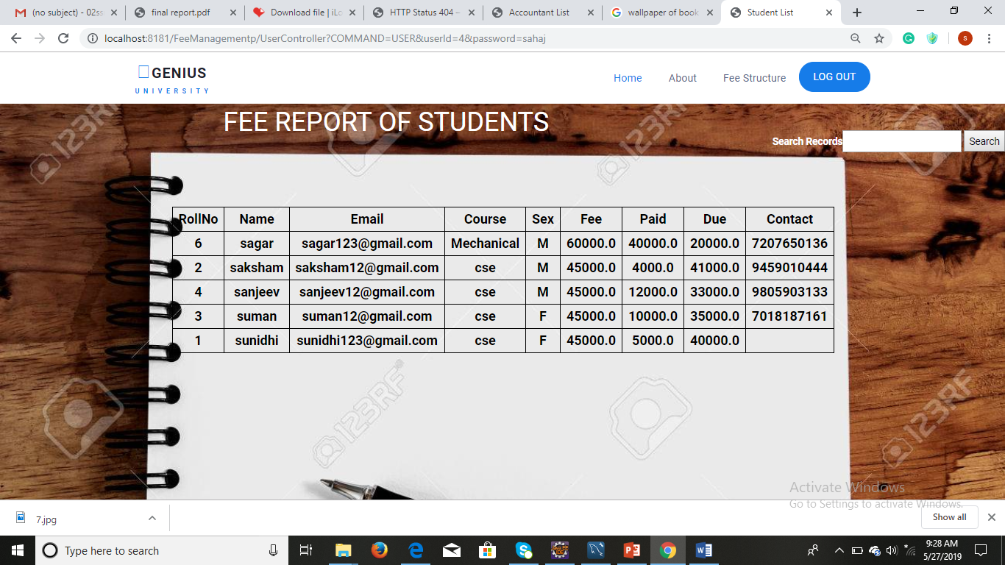
FEE MANAGEMENT SYSTEM
STUDENT LIST

Slide 7
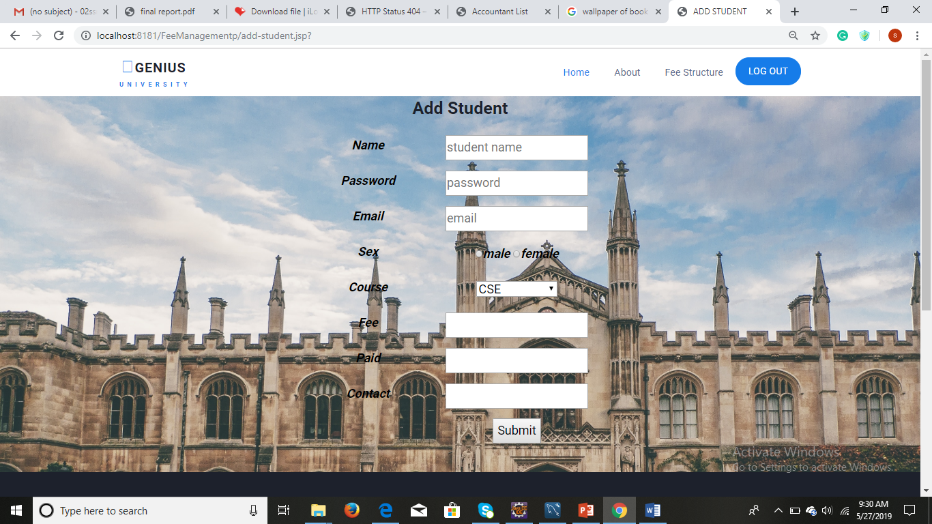
FEE MANAGEMENT SYSTEM
Add Student

Slide 8
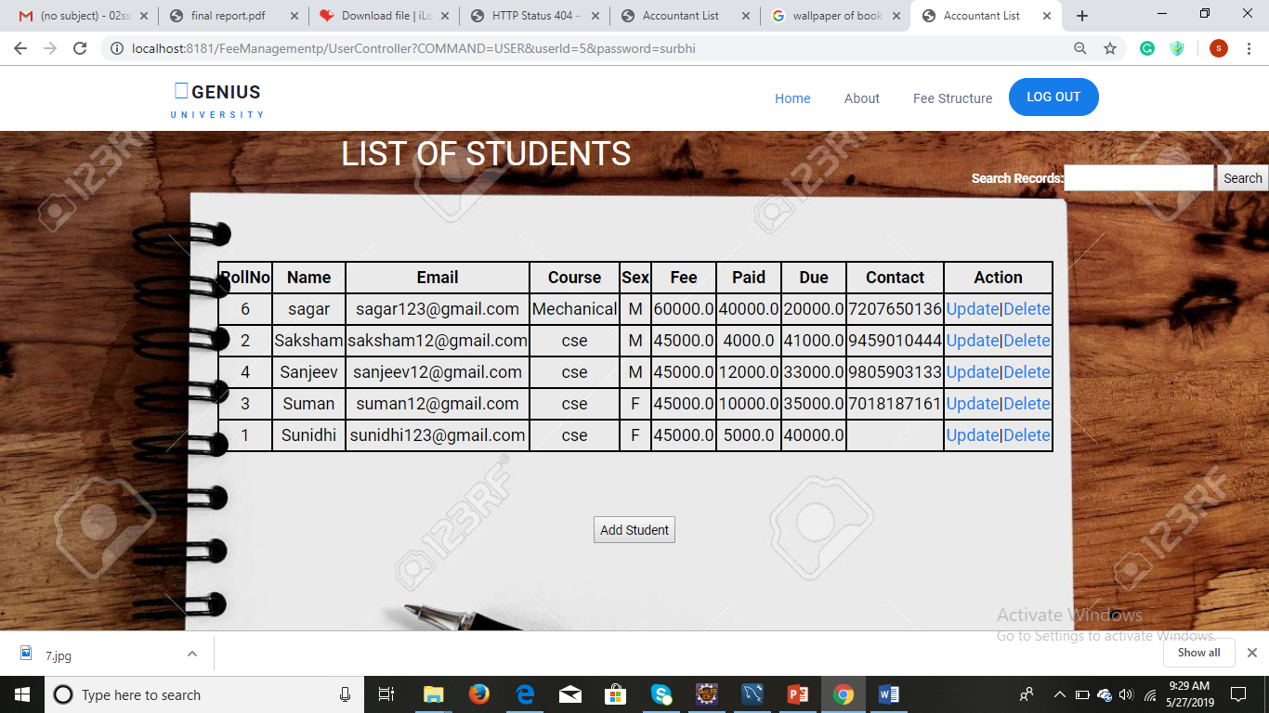
FEE MANAGEMENT SYSTEM
Update/Delete Student Record

Slide 9
FEE MANAGEMENT SYSTEM
Thank yOU

